Slide 1
Module 1.2
PRE-CLASS CONTENT
Propositional Logic

Slide 2
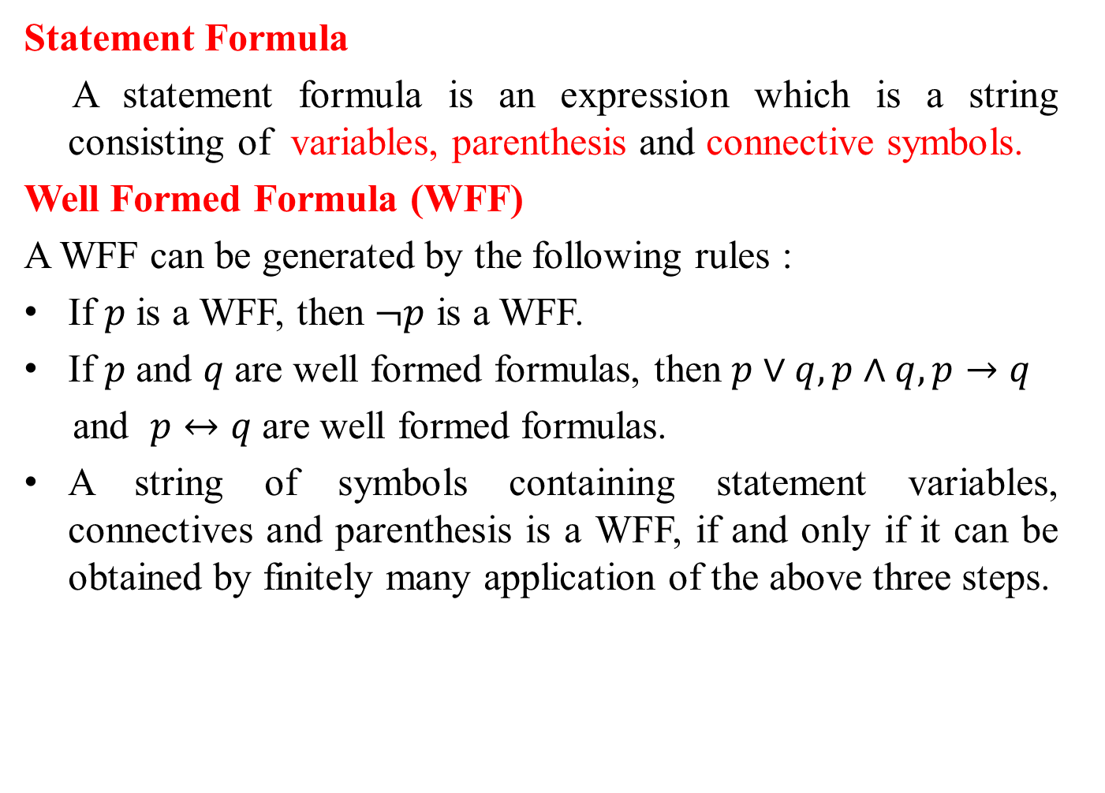
Well Formed Formula
Statement Formula
A statement formula is an expression which is a string consisting of variables, parenthesis and connective symbols.
Well Formed Formula (WFF)
A WFF can be generated by the following rules :
If $p$ is a WFF, then $¬p$ is a WFF.
If $p$ and $q$ are well formed formulas, then $p∨q, p∧q, p→q$
and $p↔q$are well formed formulas.
A string of symbols containing statement variables, connectives and parenthesis is a WFF, if and only if it can be obtained by finitely many application of the above three steps.

Slide 3
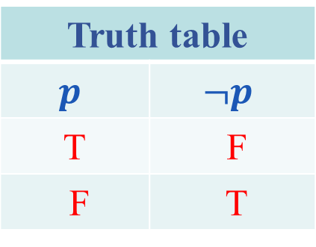

Truth tables of connectives
Negation (~ or ¬) [Not]
If $p$ is any proposition, then its negation is denoted by $¬p$
and read as not $p$ .
Truth table
$$p$$ | $$¬p$$
T | F
F | T

Slide 4
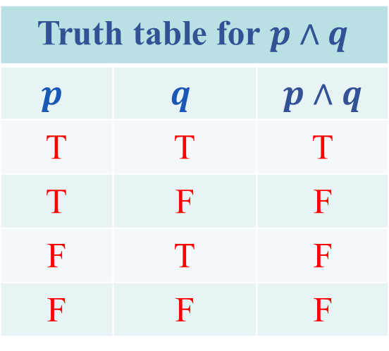
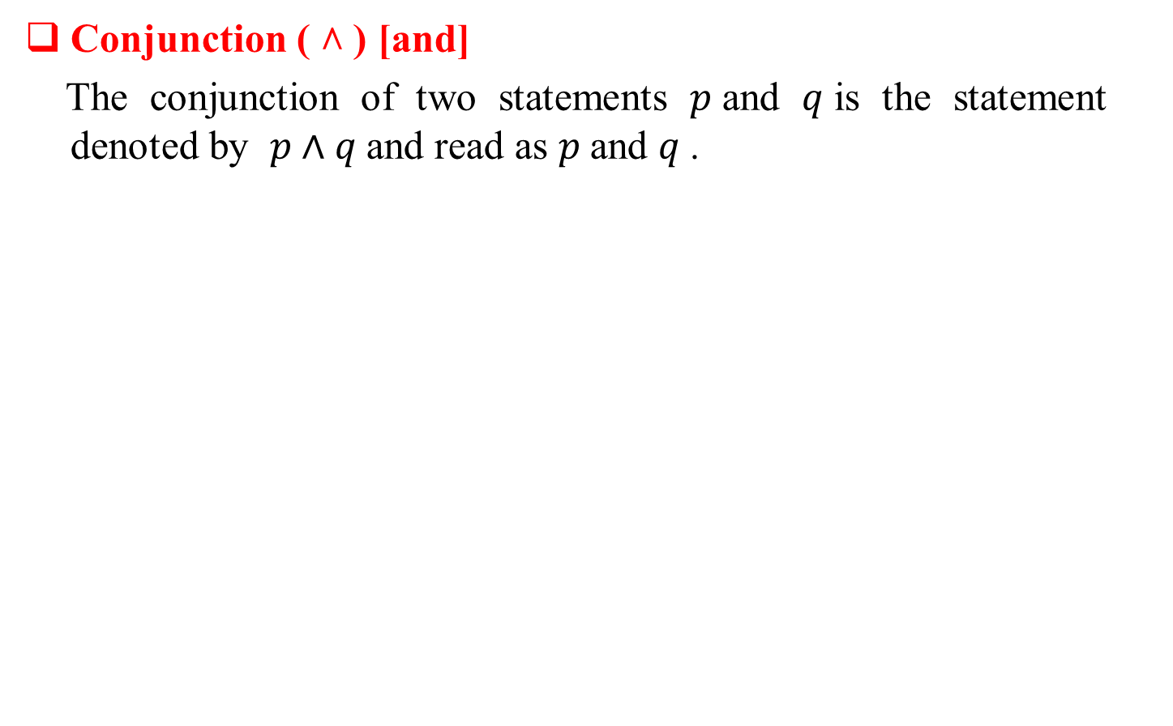
Conjunction ( ˄ ) [and]
The conjunction of two statements $p$and $q$is the statement denoted by $p∧q$and read as $p$and $q$.
Truth table for $p∧q$
$$p$$ | $$q$$ | $p∧q$
T | T | T
T | F | F
F | T | F
F | F | F

Slide 5
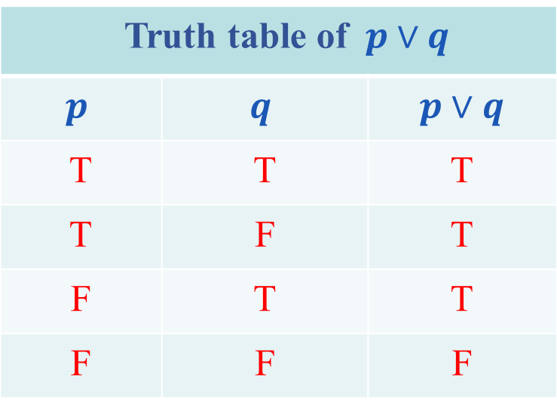

Disjunction ( ˅ ) [or]
The disjunction of two statements $p$and $q$is the statement denoted by $p∨q$ and read as $p$or $q$ .
Truth table of $p∨q$
$$p$$ | $$q$$ | $p∨q$
T | T | T
T | F | T
F | T | T
F | F | F

Slide 6

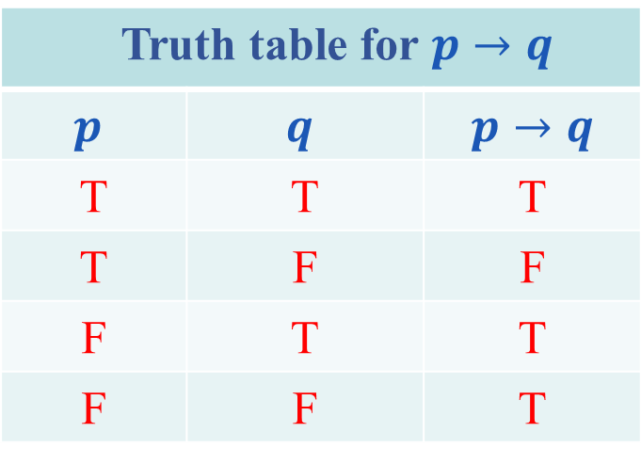
Conditional statement ( ) [If…then]
Let $p$and $q$be two statements. Then the statement $p→q$ is called a conditional statement and read as “ if $p$ then $q ”$ .
Truth table for $p→q$
$$p$$ | $$q$$ | $p→q$
T | T | T
T | F | F
F | T | T
F | F | T

Slide 7
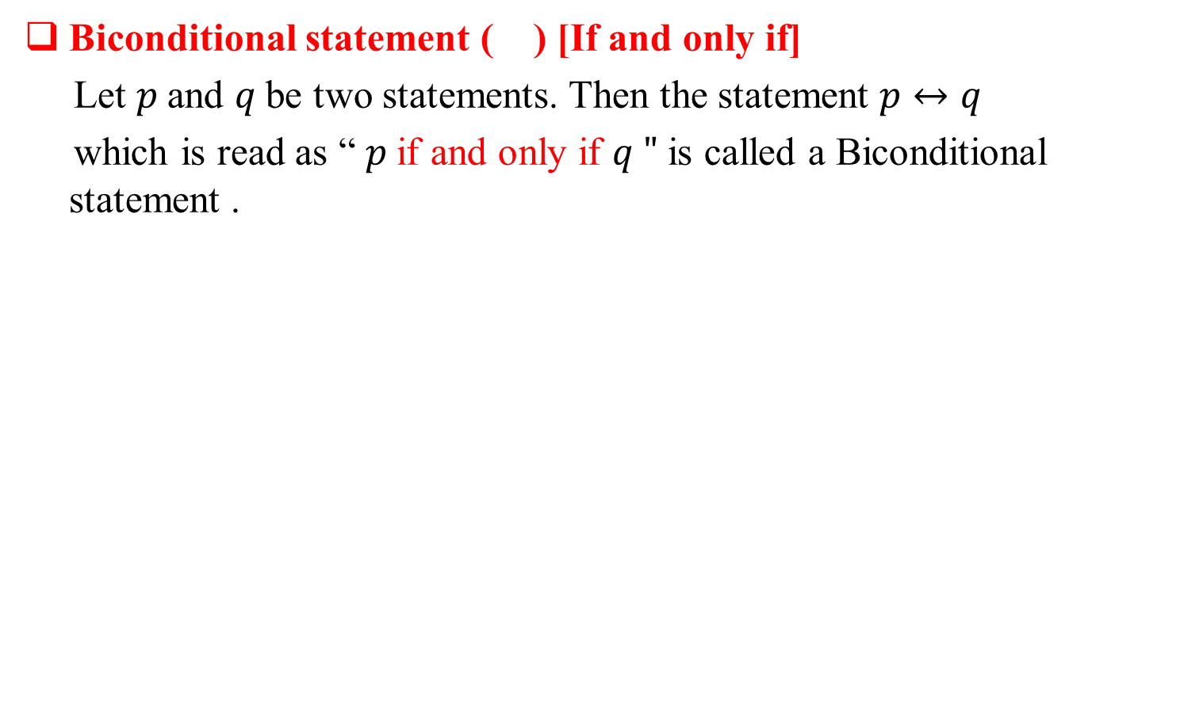
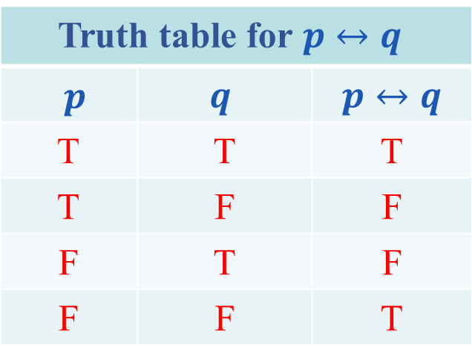
Biconditional statement ( ) [If and only if]
Let $p$and $q$be two statements. Then the statement $p↔q$
which is read as “ $p$if and only if $q "$is called a Biconditional statement .
Truth table for $p↔q$
$p$ | $$q$$ | $p↔q$
T | T | T
T | F | F
F | T | F
F | F | T

Slide 8
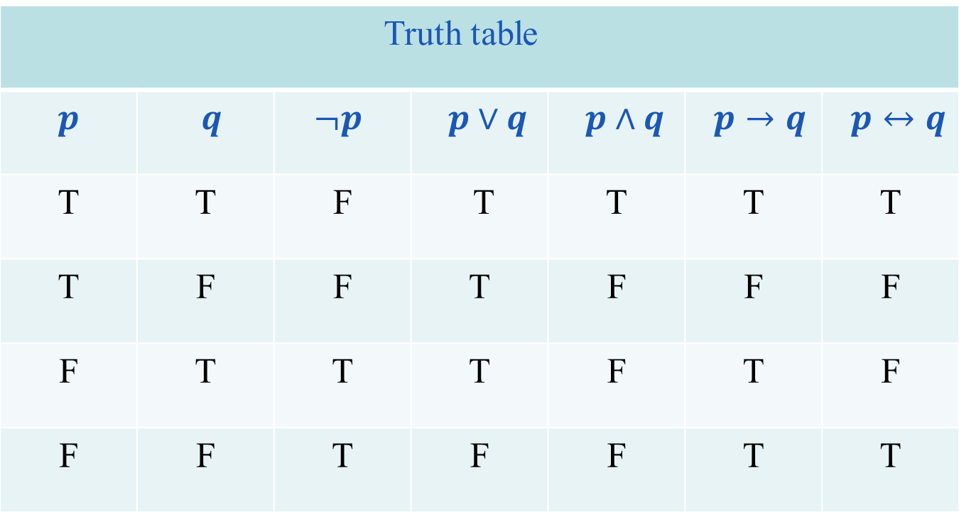
Truth values for Connectives
Truth table
$$p$$ | $q$ | $$¬p$$ | $p∨q$ | $p∧q$ | $p→q$ | $p↔q$
T | T | F | T | T | T | T
T | F | F | T | F | F | F
F | T | T | T | F | T | F
F | F | T | F | F | T | T

Slide 9
Tautology
A Tautology is a statement form that is always true regardless of the truth values of the individual statements substituted for its variables. (In the result column, all entries are True). A statement whose form is a Tautology is a Tautological statement.
Contradiction
A Contradiction is a statement form that is always false regardless of the truth values of the individual statements substituted for its variables. (In the result column, all entries are False). A statement whose form is a Contradiction is a Contradictory statement.

Slide 10
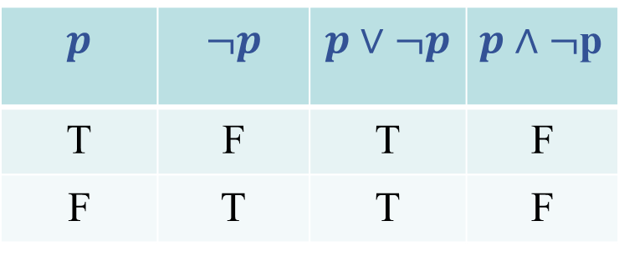
Contingency
A statement formula which is neither Tautology nor Contradiction is called Contingency. (In the result column, both True and False entries are present).
Example
The statement formula is a Tautology and that the statement formula is a contradiction.
$$p$$ | $$¬p$$ | $$p∨¬p$$ | $p∧¬$p
T | F | T | F
F | T | T | F

